Slide 1
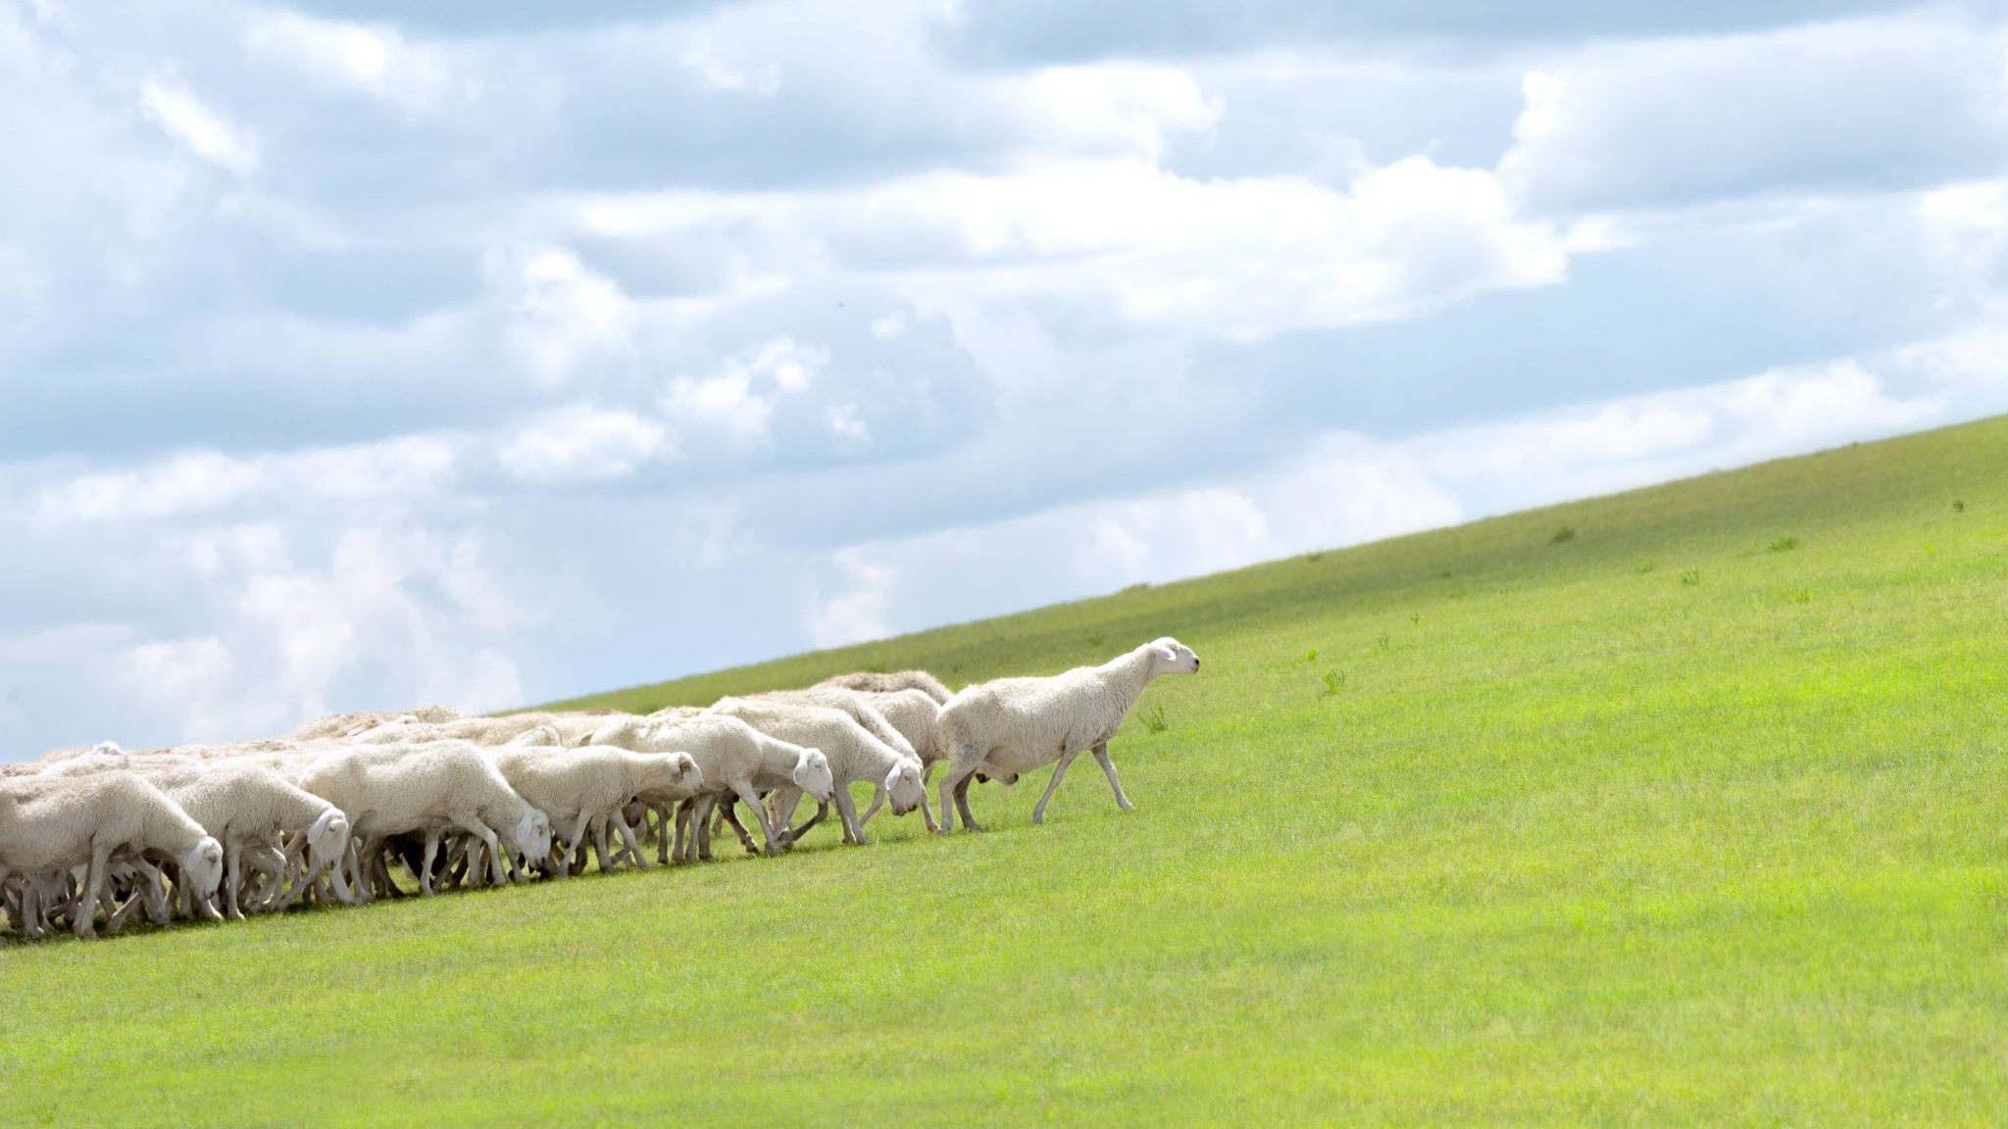

Sheepdog Driven Algorithm for Sheep Herd Transport
Vid Cesar | Gašper Habjan | Matic Hrastelj | Žan Korošak
Collective behaviour course
January 15, 2024

Slide 2
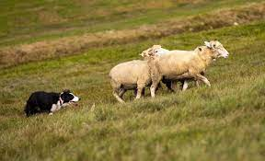
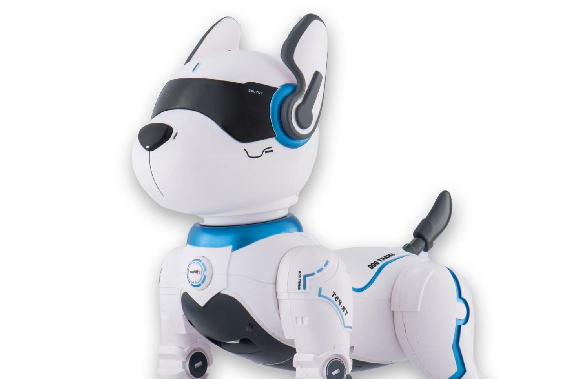
INTRODUCTION
Overview
Motivation
Optimized navigation strategies
Multiple entity coordination
Robotics
Plan
Analysis
Re-creation
Improvements/extensions

Slide 3
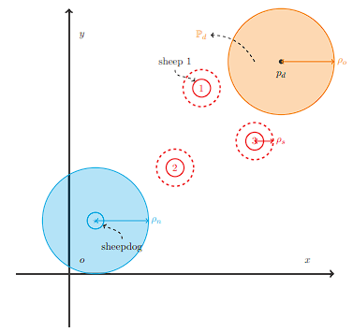
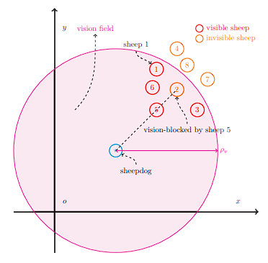
METHODS
Base sheepherding model
Sheepdog
Sheep
Sheepfold
Vision blocking
Goal
Notes:
Algorithm:
The sheepherding algorithm is split in two parts, separate for sheep and dog.
Sheep algorithm is simpler because it is based on reaction to one dog (or 2 in different implementation) and its own parameters. It calculates whether the dog is near enough to trigger a reaction to run away or if dog is far away it wanders next to the other sheep
Dog algorithm is much more complicated to implement since it has several different conditionals. In every step, dog analyzes current visible sheep and determines next step:
All sheep can be on left or right when looking directly from dog to sheepfold
If all sheep are not on one side, use the last side they were on to determine direction
Challenges:
First big challenge was understanding what was written in the base paper. It contains a lot of mathematical notation, which we were not used to. This was very hard to translate directly into code and it required some improvisation and deviation from the paper to get a working solution
We have found some issues with the parts of algorithm that were crucial to the implementation and were giving us weird interactions when implementing them in our code.
Sheep and dogs behavior are based on starting parameters. These were provided in paper for a simulation in Matlab, but were giving us some issues when using same values in our implementation. One example of this is the starting position of all sheep and the dog and the dog's radius. This was configured so that the dog would not be in range of any sheep when starting the algorithm, which concluded the search early and ended the program. Finding the most optimal parameters to properly conduct the sheepherding was a challenge.

Slide 4
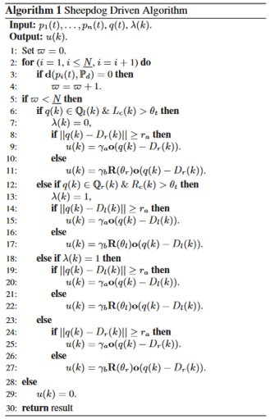
Algorithm
Base sheepherding algorithm
Sheep behaviour
Dog behaviour
Biggest challenges and how we solved them
Understanding mathematical notation
Ambiguous implementation for different parts of algorithm
Finding optimal parameters
Improvements

Slide 5
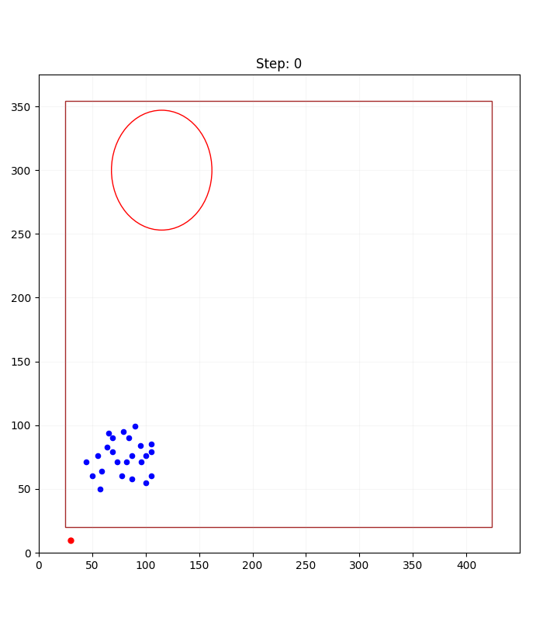
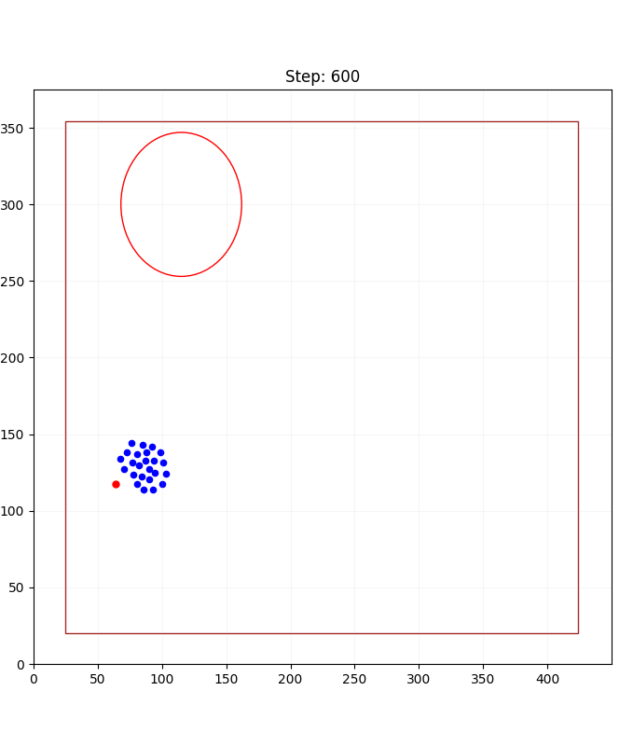
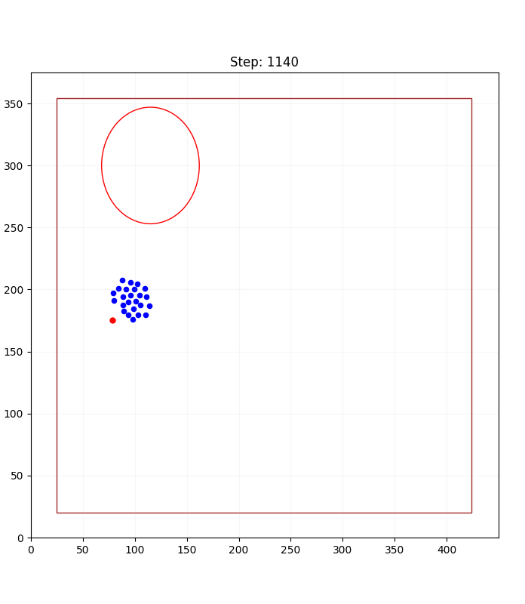
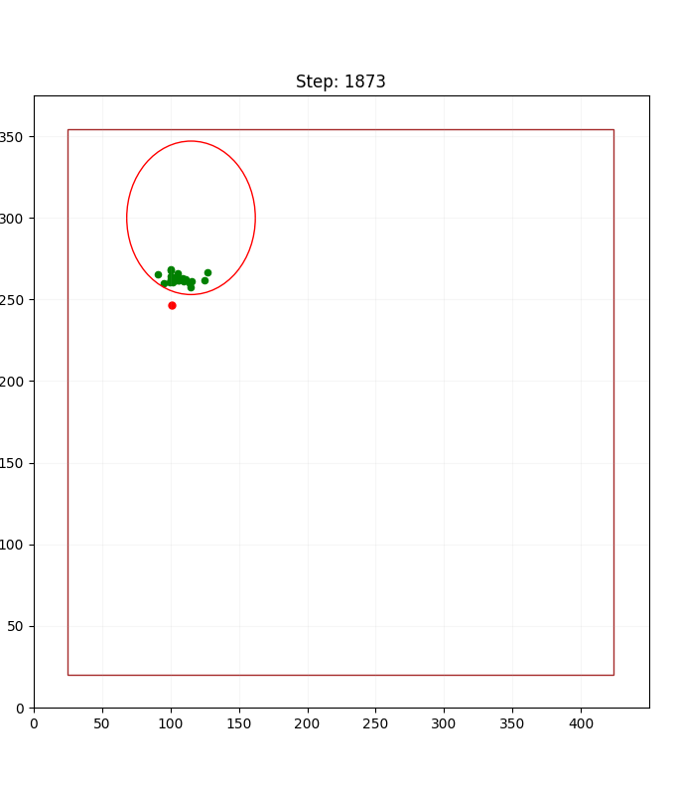
RESULTS simulation of the re-created basic algorithm (one sheepdog)

Slide 6
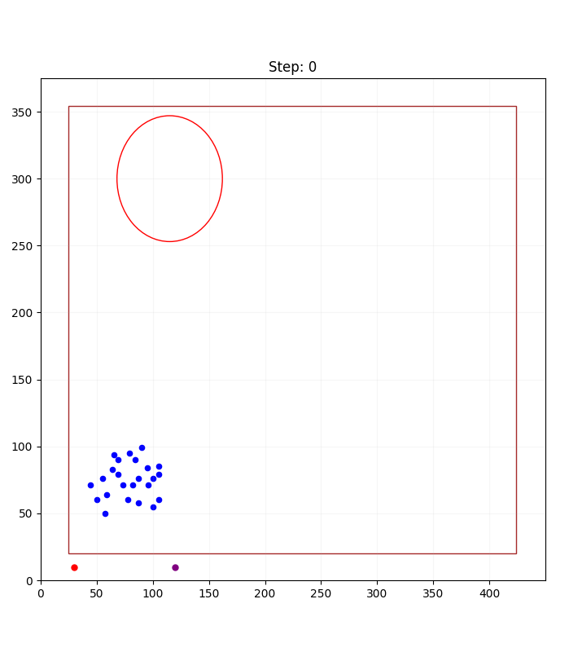
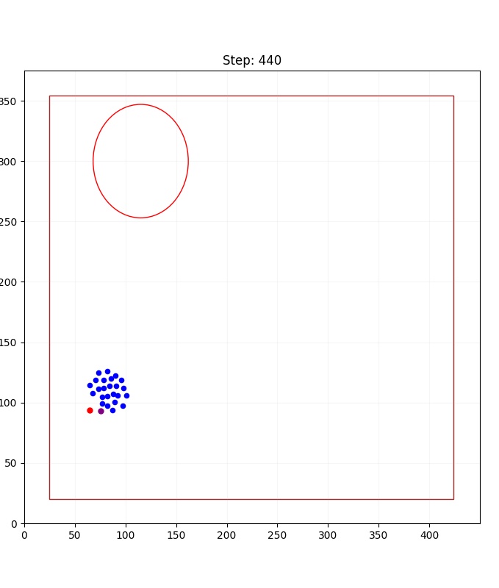
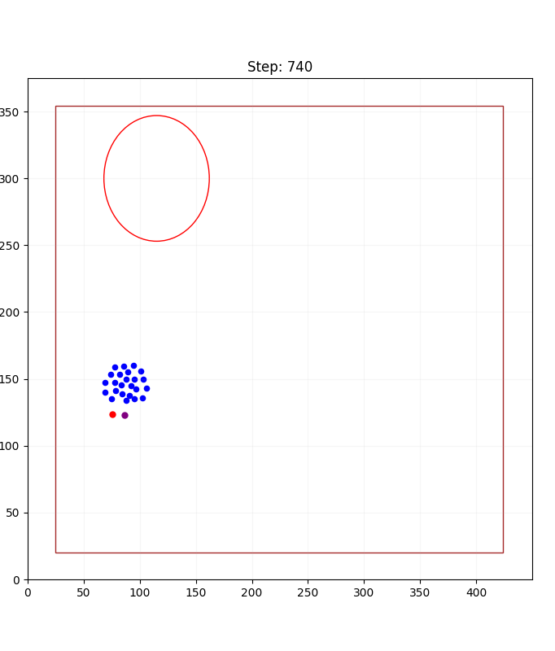
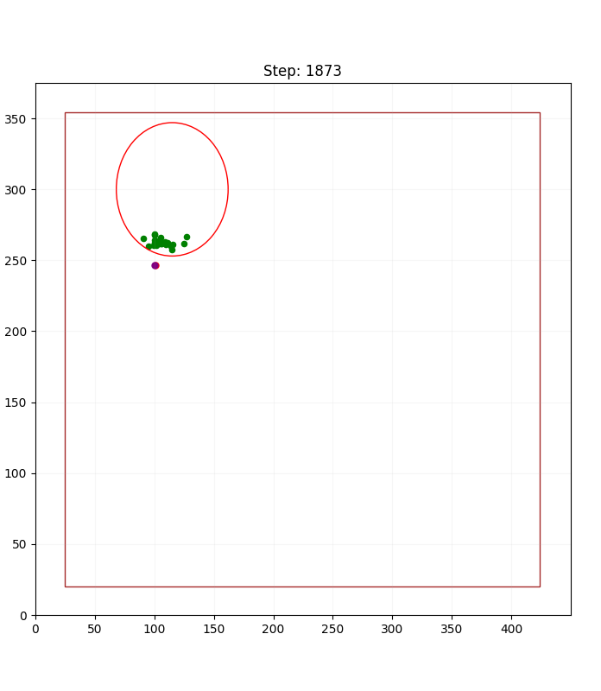
RESULTS simulation of the re-created basic algorithm (two sheepdogs)

Slide 7
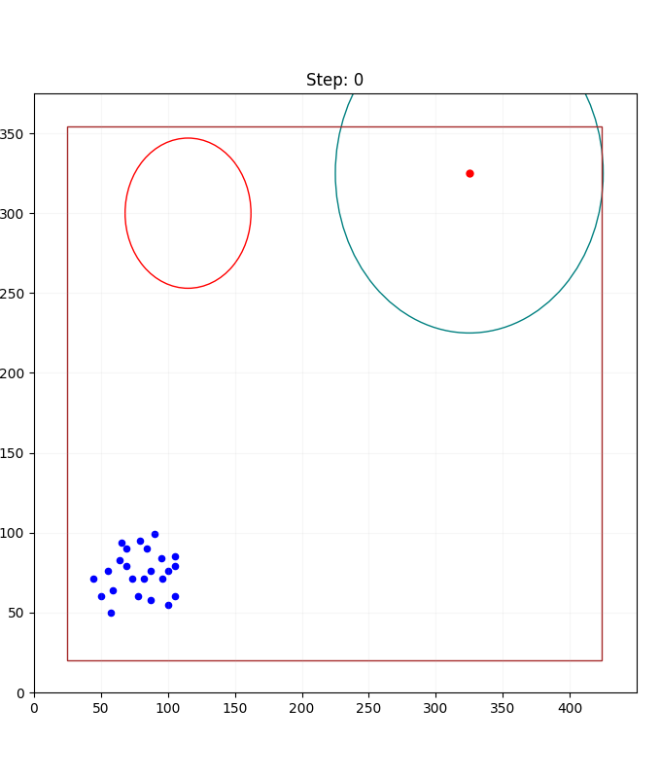
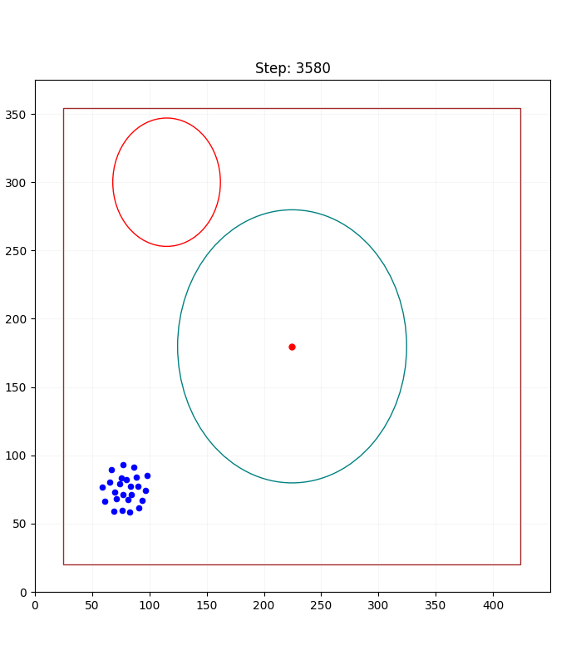
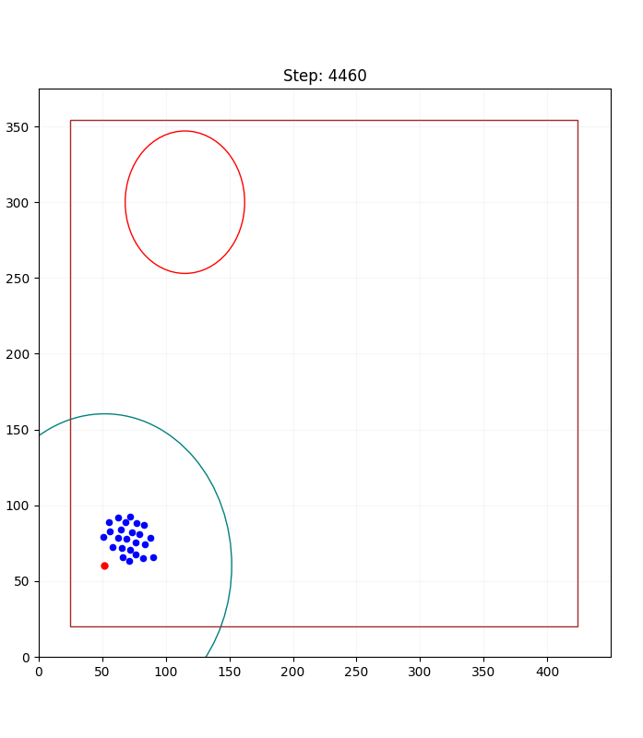
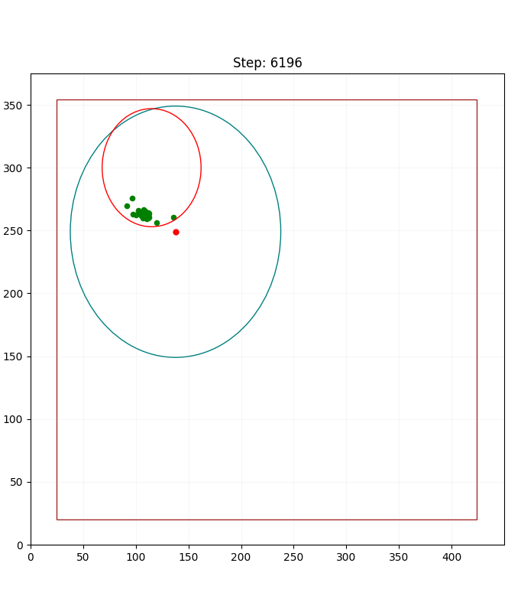
RESULTS simulation of the re-created basic algorithm (wandering)

Slide 8
CONCLUSIONS
What have we managed to achieve?
What would we change if we started all over again?
What could we possibly improve (future work)?

Slide 9
THANK YOU FOR YOUR ATTENTION
Questions?

